Slide 1
Interactive_Recipe_Finder
CAPSTONE PROJECT
Presented By:
1. Tajuddin Usman Khan - VIT AP - Computer Science and Engineering

Slide 2
OUTLINE
Problem Statement (Should not include solution)
System Development Approach (Technology Used)
Algorithm & Deployment (Step by Step Procedure)
Result
Conclusion
Future Scope(Optional)
References

Slide 3
Problem Statement
We can understand this problem statement with simple example Individuals often struggle with the daily question "what to cook," feeling overwhelmed by endless online recipes that don't match the ingredients they have on hand.
Time-Consuming Recipe Search: Manually searching for recipes that match a specific, and often random, list of ingredients is a tedious and largely fruitless task with standard search engines.
Underutilization of Leftovers: Small, leftover quantities of various ingredients are challenging to combine into a new meal and are frequently thrown away, contributing further to food waste.
Budgetary Strain: Unplanned grocery trips for specific recipes lead to impulse buys and increased food spending, making it difficult to adhere to a budget.
Food Waste: Perishable ingredients frequently spoil and are discarded because users cannot find suitable recipes that incorporate them before they expire, leading to significant household waste.

Slide 4
System Approach
Frontend Technologies
HTML5: Used for creating the semantic structure of all web pages, including the home, search, profile, and login screens.
CSS3: Responsible for all styling, including the custom background, color themes (dark/light mode), animations, and responsive layouts using Flexbox and Grid.
Vanilla JavaScript (ES6+): Powers all dynamic interactivity, such as:
Fetching data from the Spoonacular API and the backend server.
Dynamically rendering recipe cards and detailed modals.
Handling user events like form submissions and button clicks.
Managing user sessions via local Storage for tokens.
Bootstrap Grid: Leveraged specifically for its robust and reliable responsive grid system to ensure recipe cards align perfectly across all device sizes.
Backend Technologies
Node.js: The core JavaScript runtime environment that allows the backend server to execute.
Express.js: A minimal web framework used to build the REST API, defining routes for user registration, login, and saving recipes.
Mongoose: Serves as an Object Data Modeling (ODM) library to create a structured schema for user data (email, password, saved recipes) and simplify interactions with MongoDB.
JSON Web Tokens (JWT): Implemented for secure, stateless user authentication, creating and verifying tokens to protect user-specific routes.
Bcrypt.js: Used to securely hash user passwords before they are stored in the database, ensuring a high level of security for user credentials.
Database MongoDB Atlas: A cloud-hosted NoSQL database used as the primary data store for all application information, including user profiles and their corresponding lists of saved recipe IDs.
External Services Spoonacular API: Integrated as the third-party service providing all recipe-related data, including search results and detailed cooking instructions.

Slide 5
Algorithm & Deployment
Algorithm
User Authentication: New user passwords are first hashed with Bcrypt.js before being stored in MongoDB. On login, credentials are verified, and a JWT is generated and stored on the client-side to authorize future actions. Recipe Search: Users input ingredients, which are sent to the Spoonacular API. The returned recipe data is then dynamically rendered as interactive cards on the front-end.
Saving Recipes: Logged-in users can save recipes. The recipe ID is sent with the user's JWT to a secure backend endpoint, which adds the ID to the user's document in the MongoDB database.
Deployment
Hosting: The full-stack application is deployed on Vercel, with the code managed and version-controlled through a GitHub repository.
Configuration: A vercel.json file in the project root defines the build process and routing rules, treating the Node.js backend as a serverless function and the front-end as static assets.
Continuous Deployment (CI/CD): Any git push to the main branch automatically triggers a new build and deployment on Vercel, ensuring the live application is always up-to-date.

Slide 6
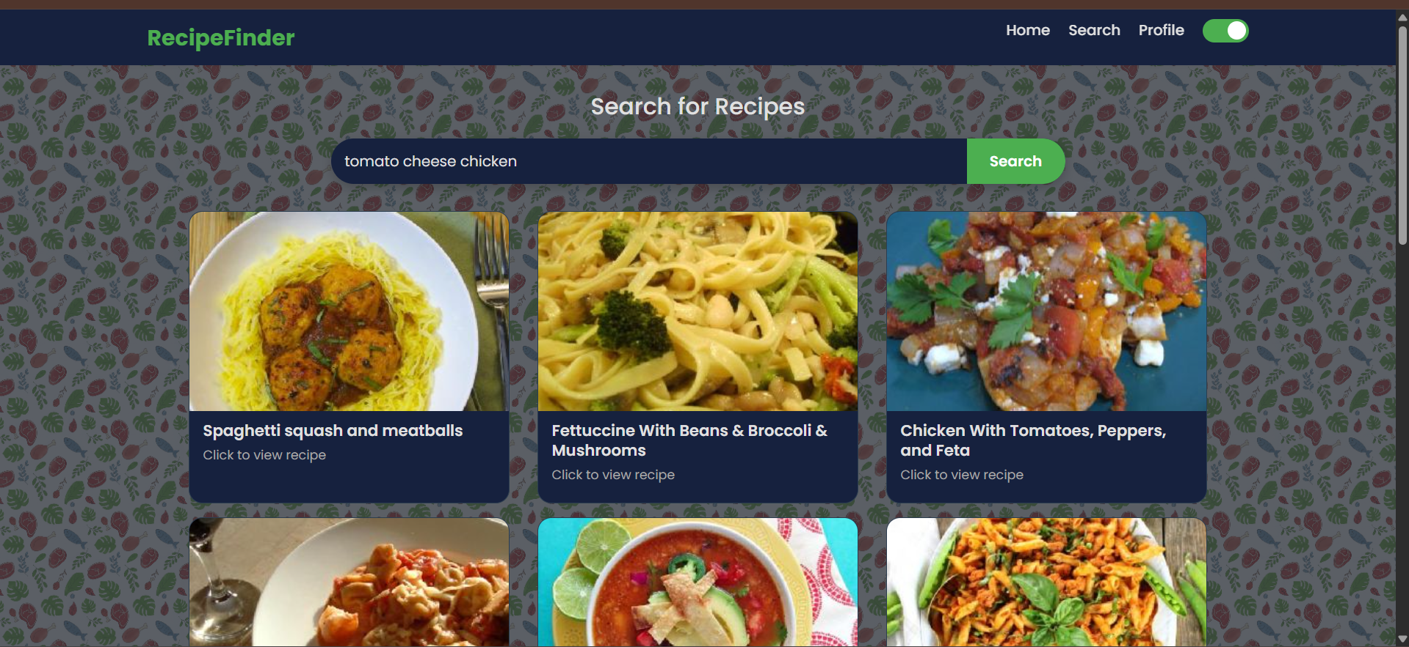
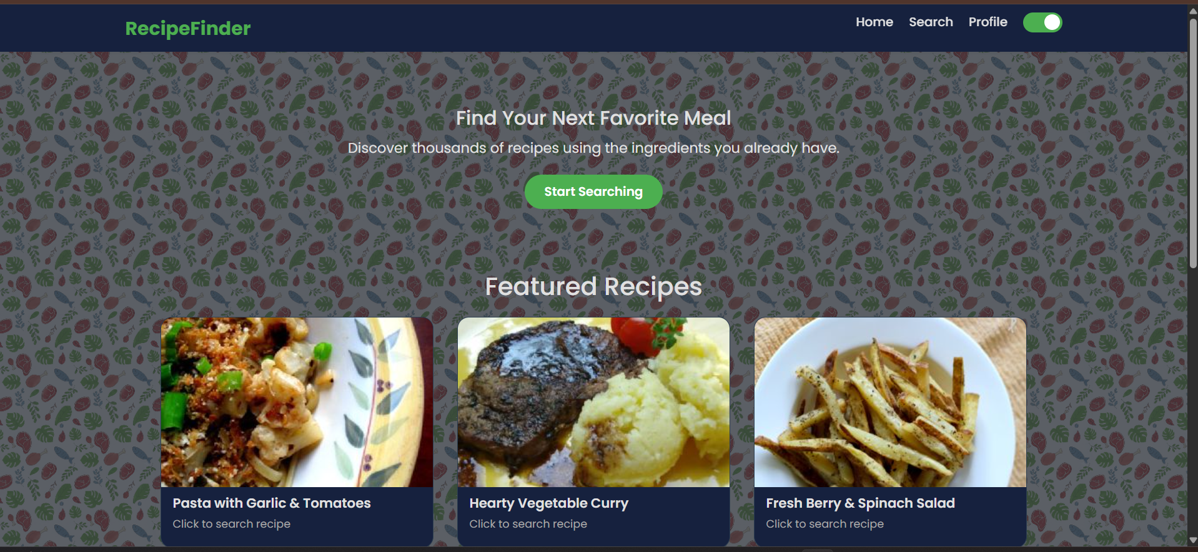
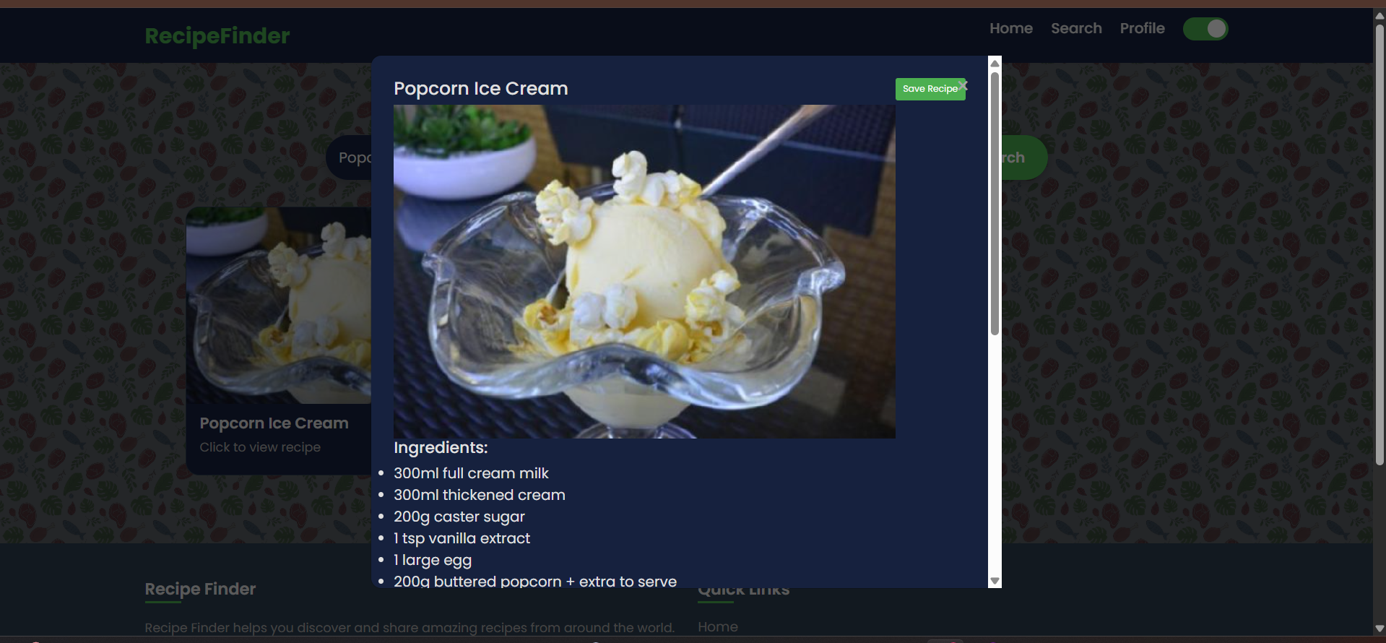
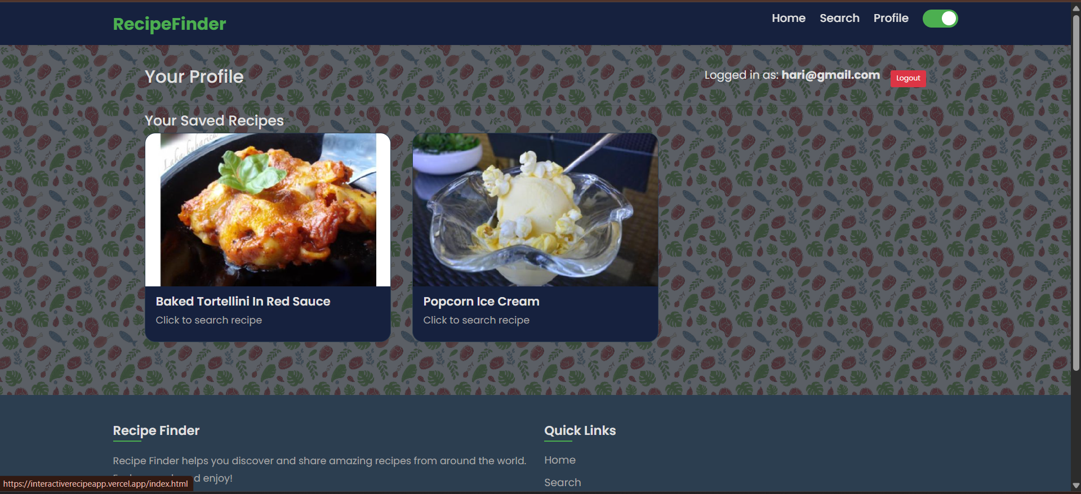
Result

Slide 7
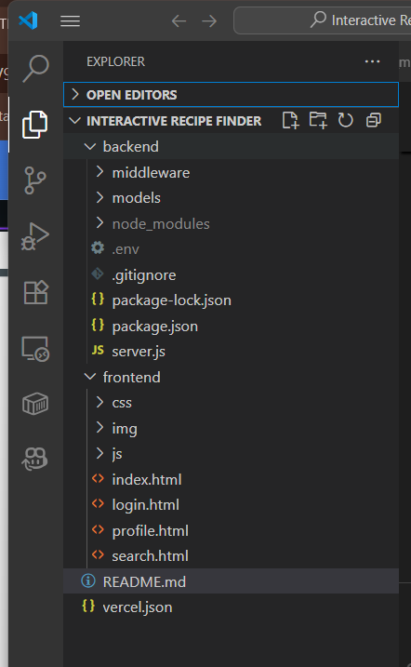
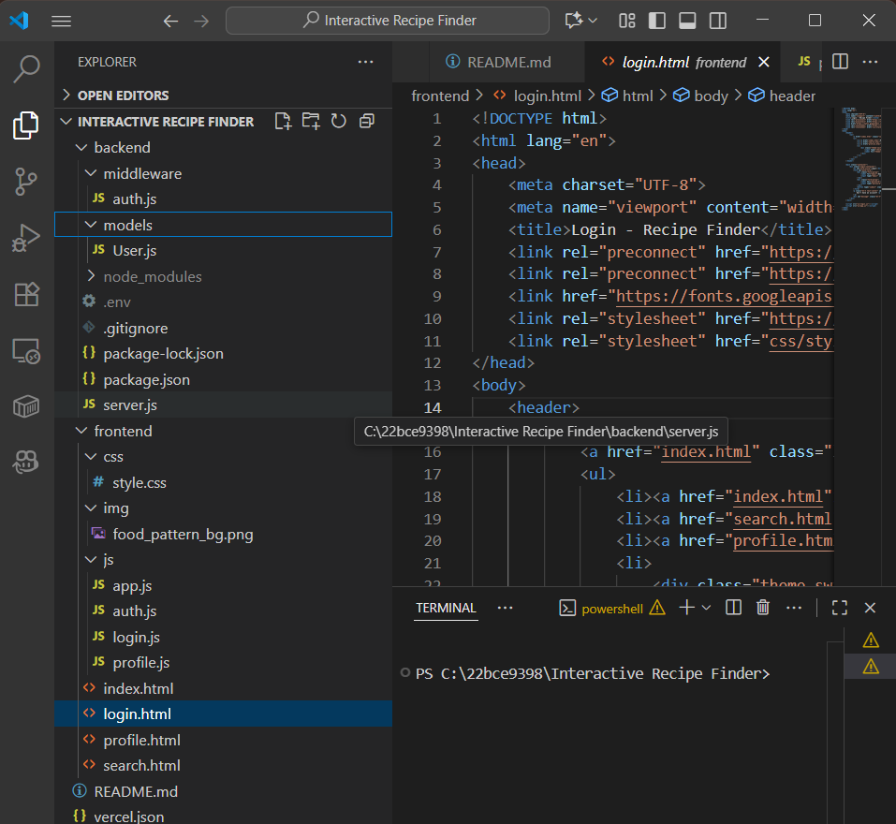
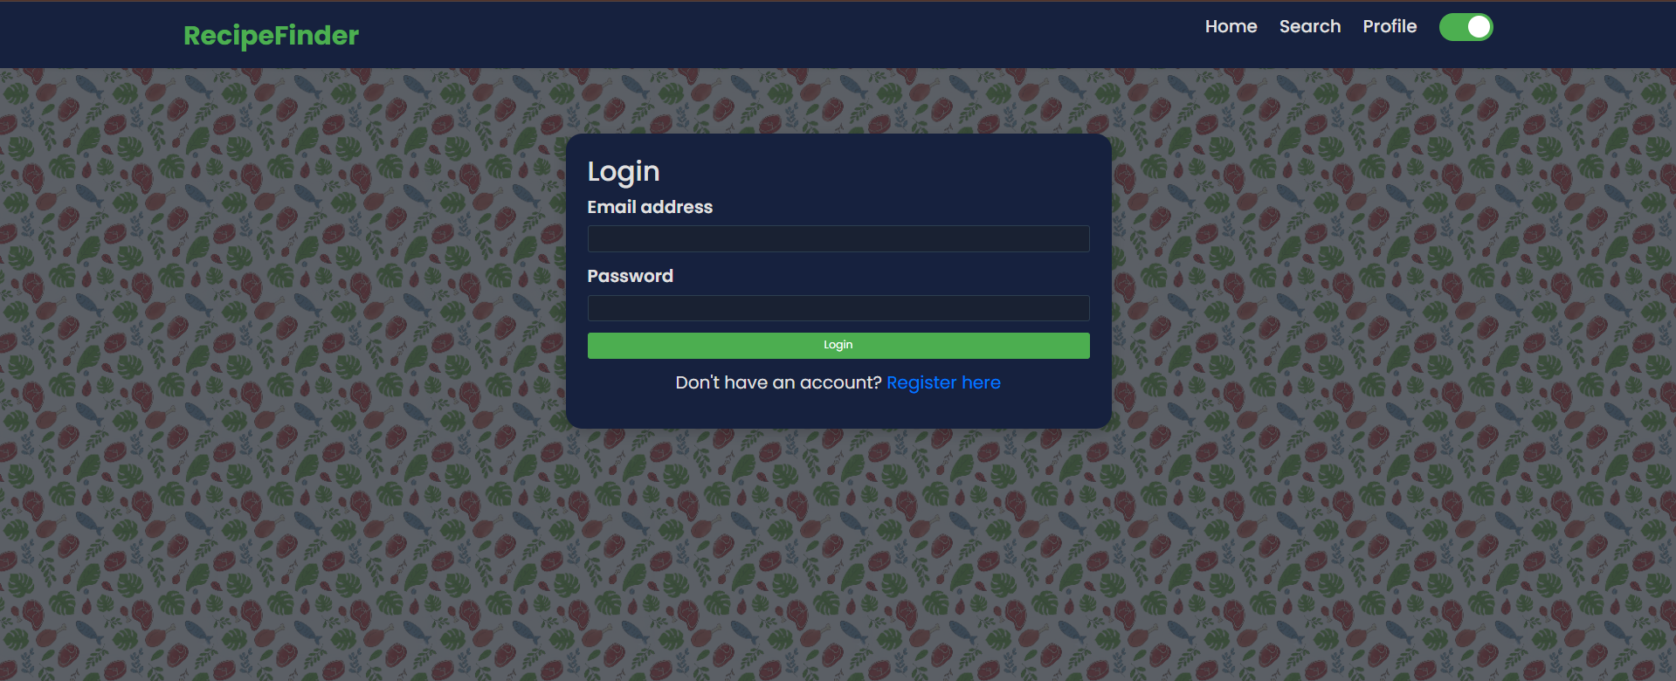
Result
REPO LINK : https://github.com/usmankhan616/EDUNET_AICTE_IBM_Interactive_Recipe_Finder

Slide 8
Conclusion
This Interactive Recipe Finder provides a practical and innovative solution to the common challenge of deciding what to cook. By intelligently generating meal ideas based on the ingredients users already have on hand, the system not only simplifies daily decision-making but also encourages resourceful cooking habits. This approach helps reduce food waste, ensures better utilization of available ingredients, and saves valuable time that would otherwise be spent searching through endless recipe options.
In addition to its functional benefits, the application offers a highly engaging and user-friendly interface, making it more appealing and accessible compared to traditional, generic recipe websites. The combination of convenience, sustainability, and interactivity enhances the overall cooking experience, turning meal preparation into an enjoyable and efficient process.
Ultimately, the project demonstrates how technology can meaningfully integrate into everyday life by addressing real-world problems. The Interactive Recipe Finder stands as a streamlined, practical, and impactful tool that empowers home cooks of all skill levels to cook smarter,waste less, and enjoy the process of preparing meals.

Slide 9
Future scope(Optional)
The Interactive Recipe Finder holds considerable potential for future development. One of the main areas of improvement is the search functionality, which can be enhanced with advanced filters such as dietary preferences (vegetarian, vegan, gluten-free), calorie calculator, cuisine type, and cooking time. These additions will make recipe selection more personalized and efficient.
Another promising direction is the integration of AI-driven features. For example, the system could generate short, step-by-step instructional videos for each recipe, providing users with a dynamic and visual cooking guide. Personalized recommendations based on past searches or frequently used ingredients could also be introduced to further improve the user experience.
Finally, expanding user engagement features, such as saving favorite recipes or tracking cooking history, would add more value and encourage long-term use of the application. Together, these enhancements would transform the project into a more intelligent, interactive, and user-friendly platform.

Slide 10
References
MongooseJS Official Documentation: https://mongoosejs.com/docs/guide.html
IETF RFC 7519: JSON Web Token (JWT): https://tools.ietf.org/html/rfc7519
Fielding, R. T. (REST Dissertation): https://www.ics.uci.edu/~fielding/pubs/dissertation/top.htm
Express.js Official Website: https://expressjs.com/

Slide 11
THANK YOU

